Slide 1
CIDOC CRM A High Level Overview of the Model
George Bruseker ICS-FORTH
ITN- DCH Digital Heritage Conference
Olimje, Slovenia
23/05/2017

Slide 2

The CIDOC Conceptual Reference Model
Developed by the CRM Special Interest Group of the International Committee for Documentation (CIDOC) of the International Council of Museums (ICOM), following an initiative of ICS-FORTH, Heraklion, Crete.
a core ontology describing the underlying semantics of over a hundred database schemata and structures from all museum disciplines, archives and libraries.
Recognized ISO Standard since 2006 (ISO21127:2006)
the result of 20 years of interdisciplinary work and agreement
a generic model of recording of “what has happened” in human scale
generates huge, meaningful networks of knowledge by a simple abstraction: history as meetings of people, things and information.

Slide 3

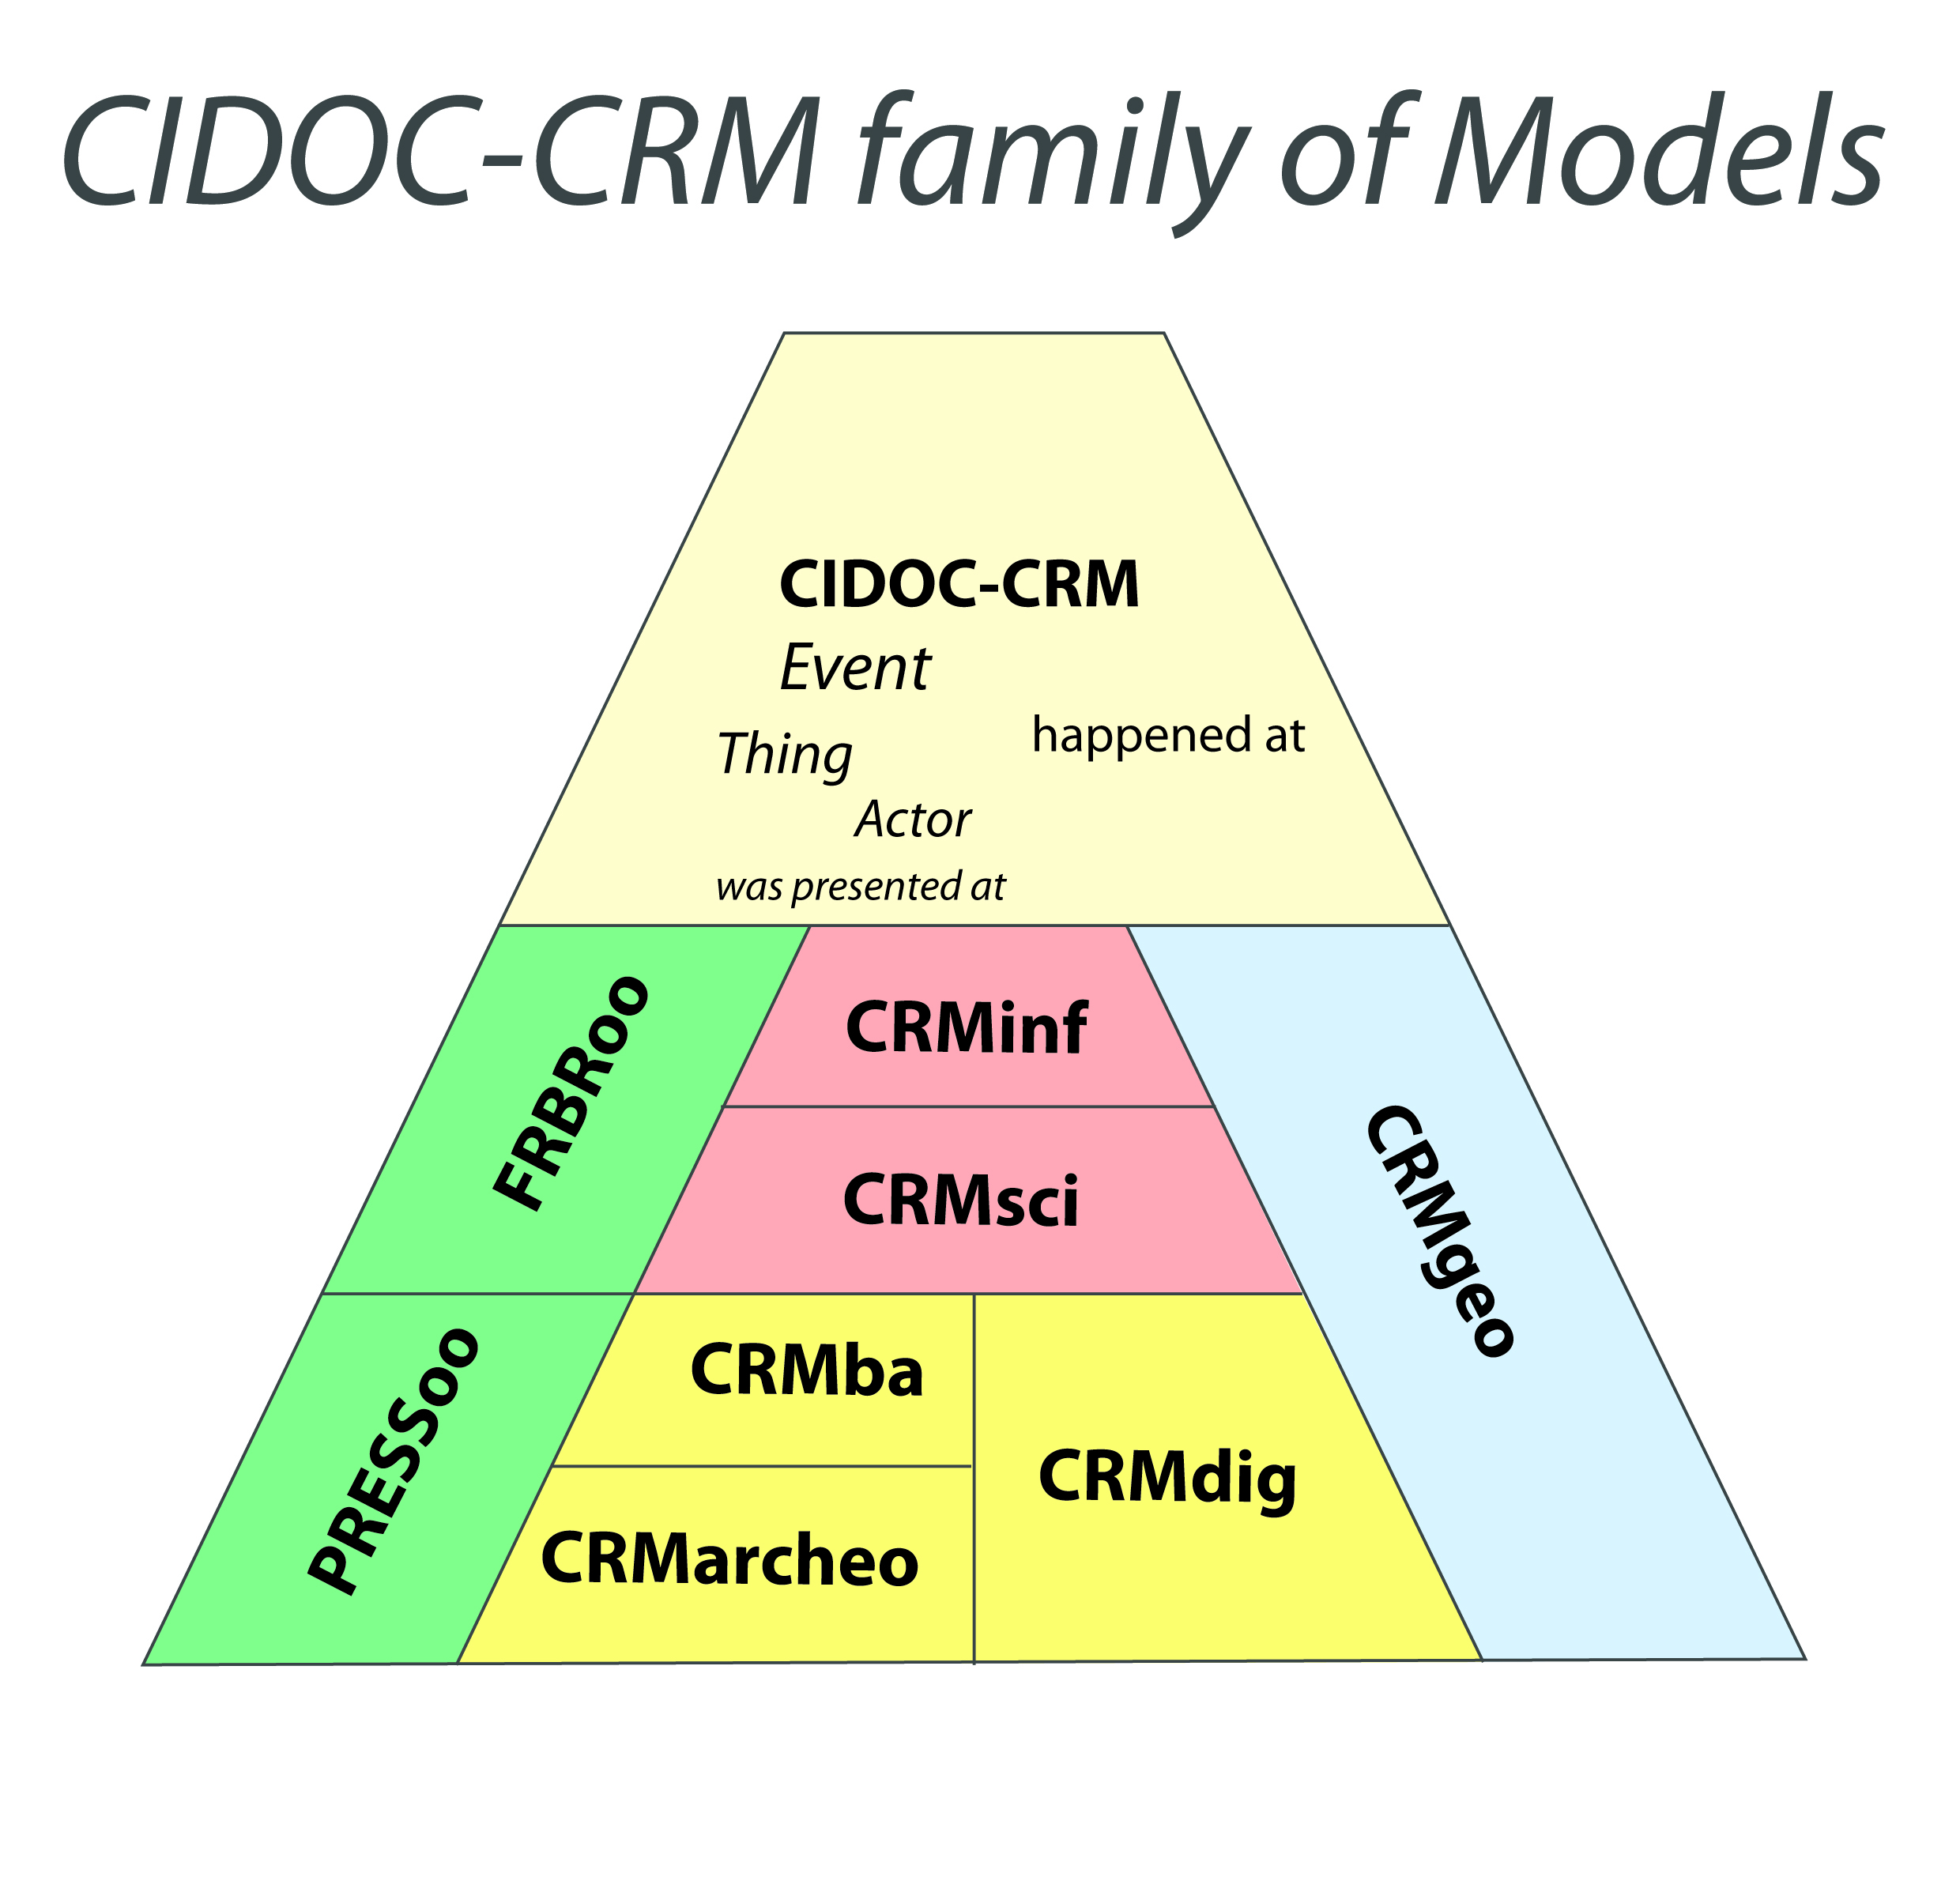
CIDOC CRM: Description
Type | Top Level Ontology
Scope | Cultural Heritage and E-Sciences
Classes | 90+-
Relations | 150+-
Version | 6
Maintained by | CIDOC CRM SIG
Official Extensions | 8
Access | http://www.cidoc-crm.org/

Slide 4
CIDOC CRM as Interlingua for CH Data Integration
We assume that we all speak about the same world
We assume that data structures are means by which to make statements about this same world
We propose an intermediary language that allows a re-expression of propositions in source data structures to an interlingua
The interlingua is successful just when it allows a semantically consistent re-interpretation of data in such a way that it is usable and comparable in a KB

Slide 5
Learning CRM like learning a language but…
CRM is a simplified language that proposes classes (nouns) and relations (verbs) that are logically defined
CRM is an artificial language; does not aspire to poetry, only allowing the representation of a pertinent set of facts
Learning CRM is much easier than learning a natural language as its basic units are highly limited and follow a common logic
Like learning a regular language we start with easier examples and move to harder expressions

Slide 6
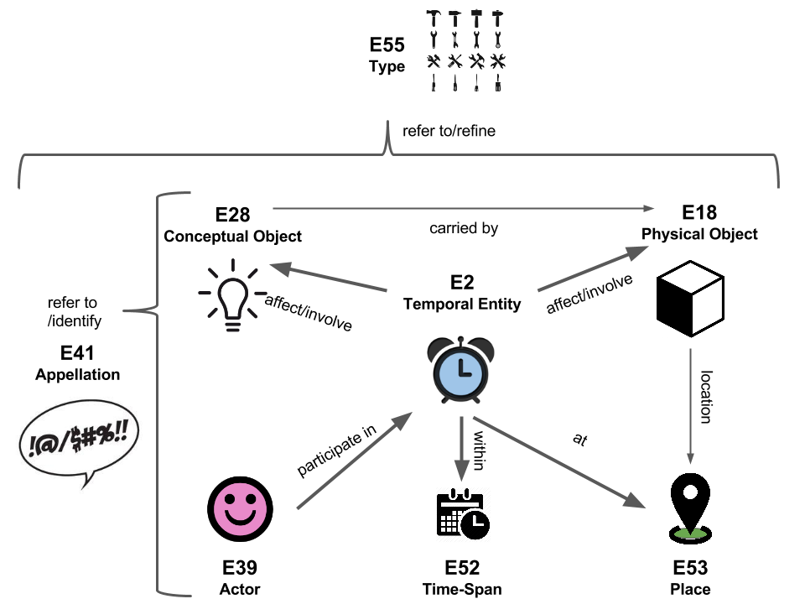
CIDOC CRM: General Modelling Pattern
IsA
Relation
Temporal Entities
Actors
Physical things
Conceptual things
Appellation
Types
Places

Slide 7

The basic CRM sentences
“George prefers others not to use his mug”
E62 String
P3 has note
P1 is identified by
P2 has type
E41 Appellation
E1 CRM Entity
E55 Type
“George’s Mug”
Mug

Slide 8
Can ask: Where was it?
E53 Place
The top CRM class for locations
E52 Time Span
E54 Dimension
E1 CRM Entity
Can ask: Is it still on-going?
Can ask:
Have you seen it before?
E2 Temporal Entity
E77 Persistent Item
The top CRM class for perdurants
The top CRM class for endurants

Slide 9
Top Level Entities Illustrated
E2 Temporal Entity
E77 Persistent Item
E53 Place
The battle of
the stick people
Two People
Swords
Triangle
Sun
The extent of
the battlefield
of the stick
people

Slide 10
Examples of Top Level Entities
E2 Temporal Entity
E77 Persistent Item
E53 Place
A handshake
A battle
A walk
The Jurassic
WW II
A kiss
hands
guns
trees
dinosaurs
bunkers
lips
The square
A field
length of the path
Jurassic South America
France
Paris
n.b.: in an actual system all instances must be particulars not generics

Slide 11
Exercise 1

Slide 12
Top Level Temporal Classes Expressivity
P4 has time-span
E2 Temporal Entity
E52 Time Span
P9 consists of
P7 took place at
E3 Condition State
E4 Period
E53 Place
P8 took place on or within
E18 Physical Thing
P11 had participant
P12 occurred in the presence of
E39 Actor
E5 Event
E77 Persistent Item
P14
carried
out by
P92 brought
into existence
E7 Activity
E63 Beginning of Existence
E64 End of Existence

Slide 13
Coming to exist
Coming to be of:
Things
People
Groups
Ideas
E68 Dissolution
E69 Death
E64 End of Existence
E6 Destruction
E81 Transformation
E67 Birth
E4 Period
E5 Event
E63 Beginning of Existence
E66 Formation
E12 Production
E65 Creation
E83 Type Creation
E2 Temporal Entity
E11 Modification
E80 Part Removal
E9 Move
E79 Part Addition
E3 Condition State
E10 Transfer of Custody
E8 Acquisition
E17 Type Assignment
E7 Activity
E87 Curation Activity
E14 Condition Assessment
IsA
E13 Attribute Assignment
E15 Identifier Assignment
E86 Leaving
E16 Measurement
E85 Joining

Slide 14
Ceasing to exist
Ending of:
Things
People
Groups
Ideas
E68 Dissolution
E69 Death
E64 End of Existence
E6 Destruction
E81 Transformation
E67 Birth
E4 Period
E5 Event
E63 Beginning of Existence
E66 Formation
E65 Creation
E12 Production
E2 Temporal Entity
E83 Type Creation
E11 Modification
E80 Part Removal
E9 Move
E79 Part Addition
E3 Condition State
E10 Transfer of Custody
E8 Acquisition
E17 Type Assignment
E7 Activity
E87 Curation Activity
E14 Condition Assessment
IsA
E13 Attribute Assignment
E15 Identifier Assignment
E86 Leaving
E16 Measurement
E85 Joining

Slide 15
Forms of Activity
Causal Activities of Agents:
On things
On Ideas
Assigning Properties
With Groups
E68 Dissolution
E69 Death
E64 End of Existence
E6 Destruction
E81 Transformation
E67 Birth
E4 Period
E5 Event
E63 Beginning of Existence
E66 Formation
E65 Creation
E12 Production
E2 Temporal Entity
E83 Type Creation
E11 Modification
E80 Part Removal
E9 Move
E79 Part Addition
E3 Condition State
E10 Transfer of Custody
E8 Acquisition
E17 Type Assignment
E7 Activity
E87 Curation Activity
E14 Condition Assessment
IsA
E13 Attribute Assignment
E15 Identifier Assignment
E86 Leaving
E16 Measurement
E85 Joining

Slide 16
Exercise 2

Slide 17
Can ask: Who did it?
E39 Actor
The top CRM class for agency
E77 Persistent Item
Can ask: What did it mean?
Can ask:
What was it?
E28 Conceptual Object
E18 Physical Thing
The top CRM class for immaterial items
The top CRM class for physical items

Slide 18
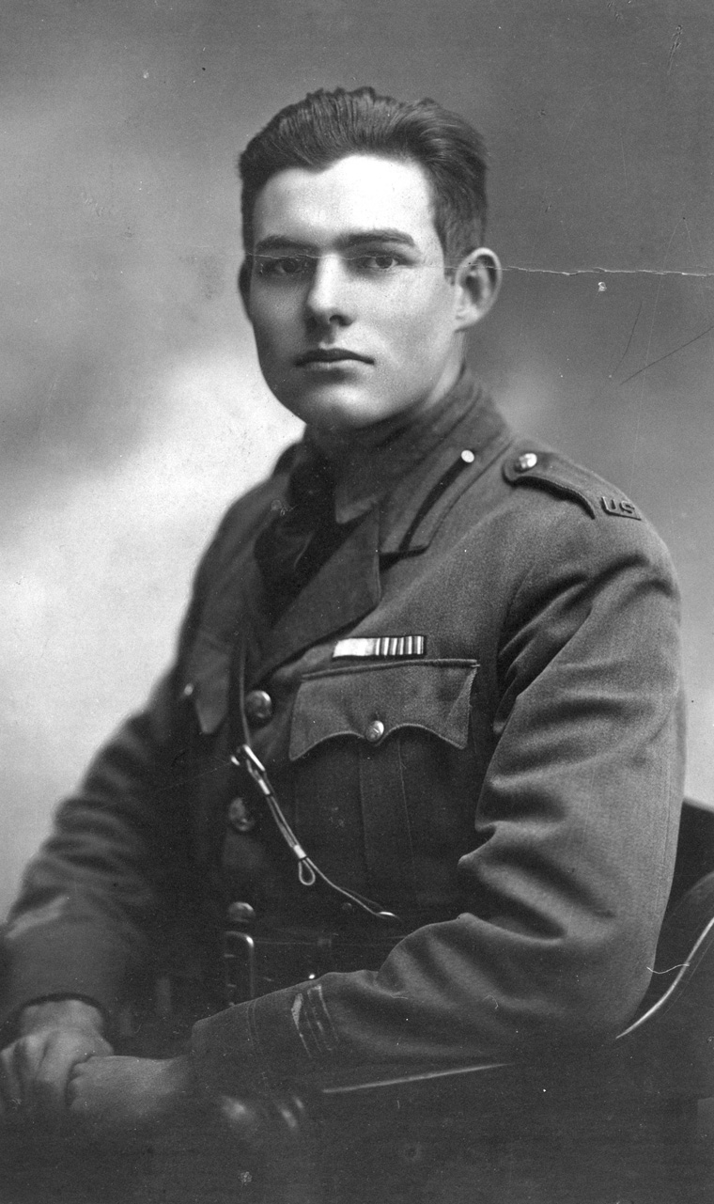

Top Level Endurants Illustrated
E18 Physical Thing
E39 Actor
E28 Conceptual Object
“In the late summer of that year we lived in a house in a village that looked across the river and the plain to the mountains. In the bed of the river there were pebbles and boulders, dry and white in the sun, and the water was clear and swiftly moving and blue in the channels. Troops went by the house and down the road and the dust they raised powdered the leaves of the trees.”

Slide 19
Examples of Top Level Endurants
E18 Physical Thing
E28 Conceptual Object
E39 Actor
This Book
Mona Lisa Painting
This CD
This Acetate Film
This Parchment
A Farewell to Arms
The Image of Mona Lisa
Beethoven’s Fifth
Citizen Kane
American Constitution
Hemingway
Da Vinci
Beethoven
Orson Welles
Founding Fathers

Slide 20
Exercise 3

Slide 21
High Level Relations between Conceptual Objects
E65 Creation
P94 has created
E28 Conceptual Object
P106 is composed of
P148 has component
E55 Type
E89 Propositional Object
E90 Symbolic Object
P67 refers to
P129 is about
E73 Information Object
E41 Appellation
E1 CRM Entity
P128 carries
E18 Physical Thing

Slide 22
Multi IsA Enables Elaboration of Following Classes
E39 Actor
P49 has former or current keeper
P46 composed of
E57 Material
E3 Condition State
E1 CRM Entity
P44 has condition
E18 Physical Thing
P45 consists of
P62 depicts
E53 Place
E36 Visual Item
P56 bears feature
P55 has current location
P65 shows visual item
E19Physical Object
E26 Physical Feature
E24 Physical M-M Thing
E20 Biological Object
E22 Man-Made Object
E25 Man-Made Feature

Slide 23
High Level Distinctions/Connections amongst Actors
E30 Right
P75 possesses
P76 has contact point
E39 Actor
E51 Contact Point
P107 has current
or former member
P74 has current or former residence
P152 has parent
E53 Place
E74 Group
E21 Person
E40 Legal Body

Slide 24
Exercise 4

Slide 25
Basic Time Statements
E62 Time Primitive
P4 has time span
P81 ongoing throughout
E2 Temporal Entity
E52 Time-Span
P83 had at least
duration
P84 had at most
duration
P82 at some time within
E62 Time Primitive
E52 Dimension
P81 ongoing throughout
before
Duration (P83,P84)
after
“intensity”
Event
time
P82 at some time within

Slide 26
Things Coming to be in Time
E7 Activity
0,n
P16 used specific object
(was used for)
0,n
E70 Thing
P125 used object of type
(was type of object used in)
0,n
E11 Modification
P32 used general technique
(was technique of)
E55 Type
0,n
0,n
1,n
E18 Physical Thing
0,n
1,n
Things may be
different from
their plans
E12 Production
P45 co nsists of
(is incor porated in)
P31 has modified
(was mod ified by)
1,n
P108 has produced
(was produ ced by)
P33 used specific technique
(was used by)
0,n
1,1
P69 is associated with
0,n
E24 Physical Man-Made Thing
0,n
0,n
0,n
0,n
P68 usually employs
(is usually employed by)
0,n
Materials
may be lost
or altered
E29 Design or Procedure
E57 Material
P126 employed
(was employed in)
0,n

Slide 27
Conceptual, Physical Relations and Reasoning
P62.1 mode of
depiction
E55 Type
P62 depicts
(is depicted by)
E1 CRM Entity
P67 refers to
(is referred to by)
E24 Physical Man-Made Thing
P128 carries
(is carried by)
E73 Information Object
P138.1 mode of
depiction
P65 shows visual item
(is shown by)
P138 represents
(has representation)
E84 Information Carrier
E36 Visual Item
E37 Mark
E38 Image
E34 Inscription

Slide 28
Place Class and Reasoning over Location
0,n
P7 took place at
(witnessed)
1,n
0,n
P88 consists of
(forms part of)
0,n
0,n
P26 moved to
(was destination of)
E4 Period
P89 falls within
(contains)
E53 Place
0,n
1,n
E9 Move
0,n
0,n
0,n
P27 moved from
(was origin of)
1,n
0,n
0,n
1,n
P87 is identified by
(identifies)
0,1
E12 Production
0,n
1,n
P53 has former or current location
(is former or current location of )
P25 moved
(moved by)
E44 Place Appellation
P59 has section
(is located on or within)
P108 has produced
(was pro duced by)
0,n
1,n
1,1
0,n
E46 Section Definition
P58 has section definition
(defines section)
E18 Physical Thing
E47 Spatial Coordinates
1,1
0,n
E48 Place Name
E45 Address
E24 Physical Man-Made
Thing
E19 Physical Object
P8 took place on or within
(witnessed)
0,n

Slide 29
Thank you
Questions?
George Bruseker
ICS-FORTH
bruseker@ics.forth.gr

